Slide 1


Department of B.VOC in
Software and Application Development

Slide 2
Sri Dharmasthala Manjunatheshwara College(Autonomous) Ujire
Empowerment through competency building with ethical foundation.
College Vision
Department of B.VOC in Software and Application Development
Year of Establishment : 2019
To enable students to be competitive through deployment of efficient skills and delivery of value added theoretical or practical understanding of a subject driven by “Innovation at its best”.
Vision
To be a globally competitive department inspiring students to do the extraordinary in providing innovative solutions powered by technology and nurturing a trusting collaboration with stakeholders.
To pioneer innovations in software and application development through industry collaborations.
Mission

Slide 3
About B.Voc Course
B.Voc courses are a newly implemented initiative by the Government of India under the Skill India scheme.
The very nature of these courses is to provide maximum scope for practical exposure and minimum for theory.
B.Vocational courses are introduced with an aim to bridge the gap between classroom learning and professional ambiances.
They instil adequate and specific career based skills in students which help them pursue their specific area of interest and excel in it early.

Slide 4
Software and Application Development
It involves the application of engineering concepts, techniques, and methods to the design, development, deployment and maintenance of software systems.
Will lead to development of student’s professional and interpersonal skills.
The program will inculcate among students a strong sense of civic, professional and ethical responsibility.
Strive to develop a capacity for innovation and a passion for lifelong learning.

Slide 5
Curriculum
-The very nature of B.Voc in S&AD is to provide maximum scope for practical exposure and minimum for theory with 60% focus to practical implementation and 40% to theoretic learning.
Classroom learning, lectures, lab sessions, project work, seminars, group assignments, presentations and interactions with industry experts are all part of B.Voc curriculum.
All of the department sponsored programs are intended to supplement the academic aspects of the department. Syllabi are consistently upgraded to encompass latest developments in the software field such as newest & most advanced programming languages.

Slide 6
Faculty profile
Sl. No | Name | Qualification with Institute Name (PG, KSET/NET, Ph.D.) | Area of Specialization | Years of Service Teaching/Research/Industry | Additional Qualification
1 | Sammed Jain | B.E in Computer Science | Web Application Development | 3.5
2 | Yashoda S Patil | M.Sc in Computer Science | Computer Science | 3 (months) | CLIS - Certification Library And Information Science
3 | Rakshitha H J | M.Sc in Computer Science | Computer Science | 7 | PG Diploma in Computer Application

Slide 7
SWOC
Strengths
Qualified, Competent, Research oriented and Dedicated faculty.
Well equipped Lab and Class Rooms, practical exposure and current technology syllabus.
Weakness
Lack of awareness about the course to students, parents and IT Sectors.
Opportunity
Students have good career opportunities in different IT departments, Advanced carrier in Computer Applications and provides a way towards PG courses .
Challenges
Developing structural approach to industry collaborations.
To create an awareness about the course.

Slide 8
Teaching, Learning & Evaluation valuation Evaluation
Updated syllabus as per the current needs and trends to improve the quality of education through consultation with industry experts, Practical Exposure, ICT.
Practical exposure ,workshops ,internship programs in association with IT industry, self learning activity, involving students in real time projects.
Mentorship, Remedial drills, Individual and group guidance, IESA, Internal examinations, feedback collection, Self Evaluation, practical Assignments.

Slide 9
Student Strength
Year | Approved Strength | Total Students Admitted | Boys | Girls
2019-20 | 30 | 26 | 12 | 14
2020-21 | 50 | 46 | 34 | 12
2021-22 | 50 | 50 | 39 | 11

Slide 10
Results

Slide 11
Placement and Higher Studies details
Placement details
Sl No. | No of Students | Company | CTC
1 | 4 | Accerlab Technology | 3.2LPA
2 | 1 | Byjus | 5 LPA
3 | 3 | Metasoft | 2.2LPA
4 | 2 | SME | 2 LPA
5 | 3 | Toyota | 2LPA
Higher Studies
Sl No. | No of Students | College
1 | 7 | Nitte University

Slide 12
Department Contribution to the College through Projects.
S.D.M -Canteen Management
Rate My Food -S.D.M Hostel food rating Web Application
Ideal Bits – Department Student Association project
S.D.M -Arboretum

Slide 13
Unique Students Projects
2.
S.D.M Placement
6.
Agro Cart
1.
Home Automation
3.
Carry Cart Shopping App
5.
Cricket Score Application
7.
Fire Fighting Robot
4.
Complaint Processing System Grama Panchayath

Slide 14
Research And Extension
Name: Mrs. RAKSHITHA H J
Department: B.Voc in Software and Application Development
Designation: Assistant Professor
Qualification: M.Sc. in Computer Science
Publications: "Significance of Searching and Sorting in Data Structures”. International Research
Journal of Engineering and Technology (IRJET). Volume: 05 Issue: 04 | Apr42018
“An Approach to JDBC”. Journal of Emerging Technologies and Innovative Research
(JETIR). Volume 6 Issue 6, June 2019 “An Approach to Generics &amp; Collections”. International Journal of Innovative Researchin Technology (IJIRT). Volume 7 Issue 8 Jan2021

Slide 15

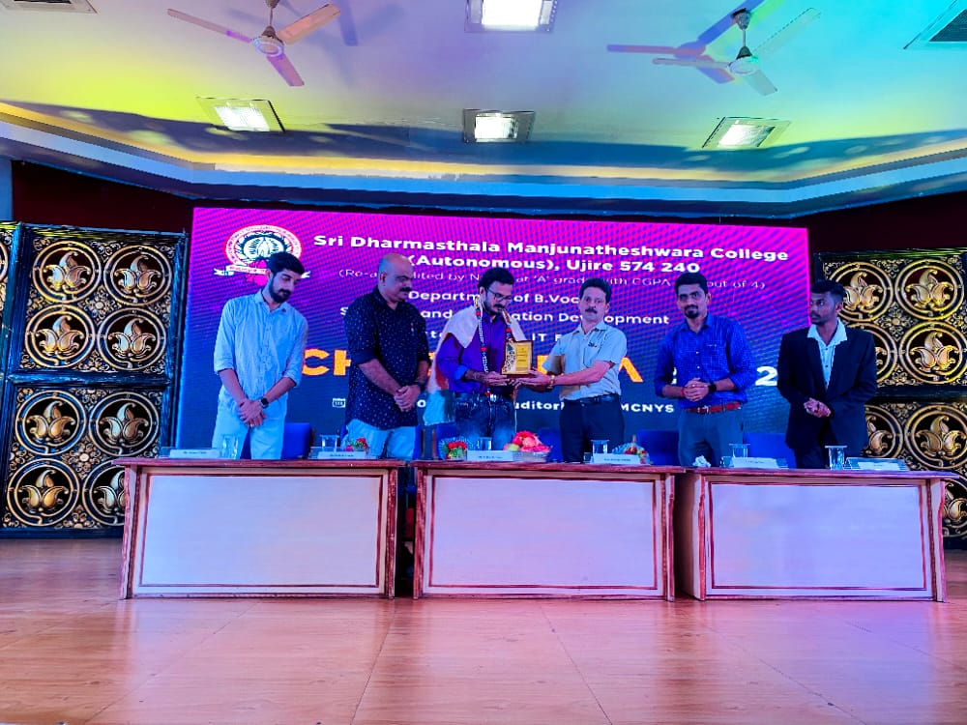
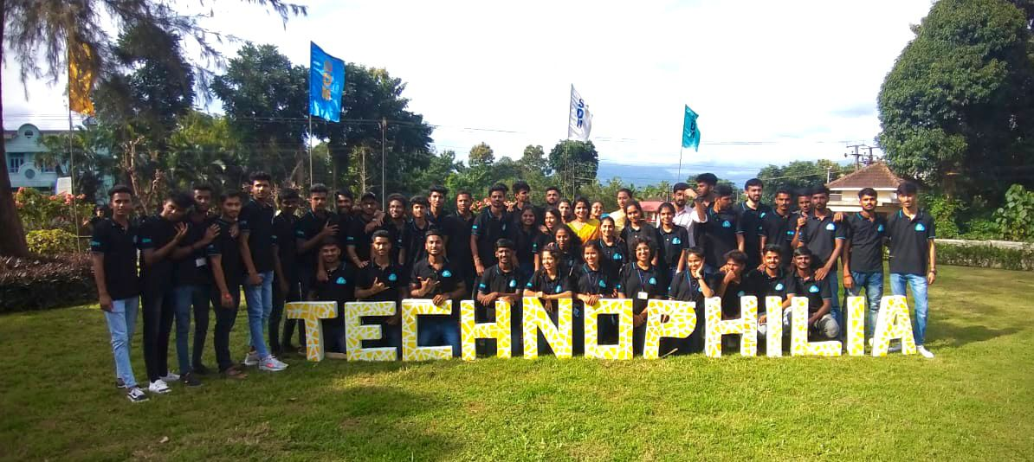
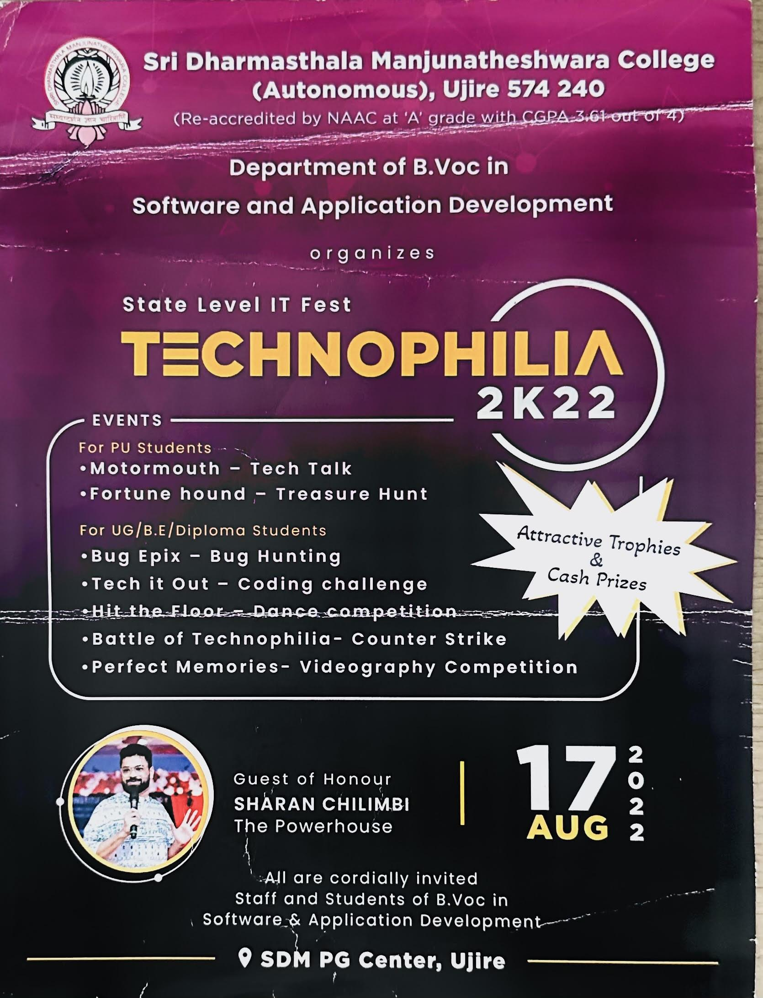
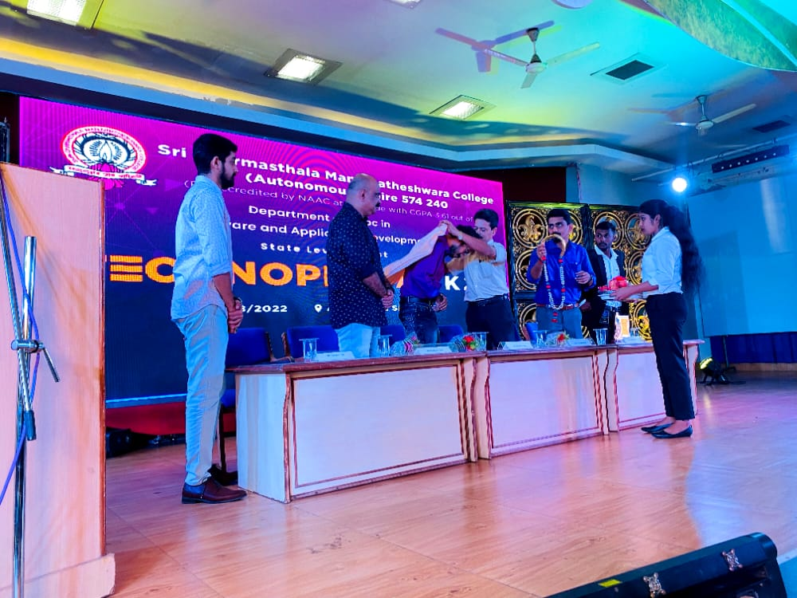
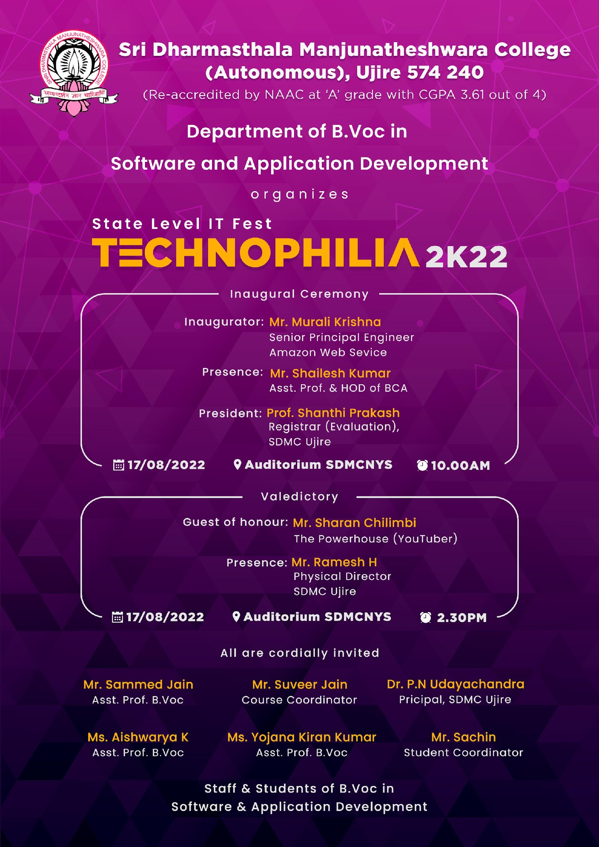
Association of the Department
Student Association Name: Ideal Bits

Slide 16
Unique features of the Department
Mandatory practical hours
Pre-Placement Training and Campus Placement
Mandatory online courses / 880 Courses
Industrial Associations
Regular Internships & Workshops (15 Days)
Impact oriented projects by students
Routine Expert Talks
Stimulating Student Start-Ups
Employability skill development

Slide 17
MoUs (Industry associations) of the Department
SL NO | Company Name | Name and Designation | Address
1 | iTech Analytic Solutions (iTAS) | Aadi Puttaswamy T Chief Executive Officer (CEO) | Corporate Office #9, 1st Floor, 8th Main, 9th Cross, SBM Colony, Brindavan Nagar,Mathikere, Bangalore – 560 054
2 | Softionik | Mr. Sunil Managing Director | Corporate Office #16-6-292/18, 2nd Floor, Dwaraka Complex Arya Samaja road, Balmatta, Mangalore – 575 003
3 | Accelerlab | Mr. Krishnamoorthy Bhat Kakunje Director & CEO | Door no.93(16), MITE Incubation Centre, Third Floor of PG Block, Badaga Mijar, Moodbidri,Karnataka-574225
4 | VARIO | Mr. Ram Prasad Chief Technology Officer (CTO) | #92/9, 3rd Floor, Above Big Bazar, 8th Block, Kathriguppe Main Road, Raghavendra Layout, Banashankari 3rd Stage, Bangalore,, Karnataka 560085
5 | IT & AI Solutions | Mr. Sadanand Pamadi Co-Founder | Opposite to Vaibhav Apartment Near Old Income Tax Office, Vidyanagar Hubballi.

Slide 18
MoU’s of the Department
SL NO | Company Name | Name and Designation | Address
6 | Karunadu Technologies Pvt.Ltd | Mahesh Deginal Founder &CTO at Karunadu Technologies Pvt.Ltd | #17,ATK complex,4th Floor, Acharya College Main Road, Beside Karur Vysya Bank, Guttebasaveshwaranagar Chikkabanvara,Bengaluru Karnataka 560090

Slide 19
Internship details
SL NO | Internship | Company Name | Duration | No.of students
1 | C, C++, java Script , MySQL. | Softionik Pvt.Ltd. | 15 days 21-11-2019 to 07-12-2019 | 26
2 | Activities in Development and Desigining Development | VARIO Software Solutions Pvt.Ltd. | 3 months 01-04-2020 to 01-07-2020 | 03
3 | Machine learning with Python | Accelerlab Technologies Pvt.Ltd. | 3 months 01-07-2020 to 03-10-2020 | 25
4 | Web development using technologies liHTML, CSS, BOOTSTRAP, javaScript and PHP | Accelerlab Technologies Pvt.Ltd. | 3 months 01-07-2020 to 03-10-2020 | 26
5 | Data Science using Python | Ethical Edu fabrica Pvt.Ltd. | 1 month 24-0 8-2020 to 24-09-2020 | 01

Slide 20
Internship details
SL NO | Internship | Company Name | Duration | No.of students
6 | Android App development using ionic framework | Softionik Pvt.Ltd. | 15 days 27-01-2021 to 09-02-2021 | 24
7 | Web development Technology using PHP | Accelerlab Technologies Pvt.Ltd. | 15 days 24-05-2021 to 10-06-2021 | 45
8 | Android App development using Java | Accelerlab Technologies Pvt.Ltd. | 3 months 01-06-2021 to 31-09-2021 | 14
9 | Advanced Javascript & ReactJs Internship | Webodaya in association with Accelerlab | 3 months 12-07-2021 to 12-10-2021 | 45

Slide 21
Certificate Courses (Online mode)
SL NO | Topic | Platform | Duration | No.of students
1 | HTML Fundamental course | Sololearn | 1 month | 26
2 | PHP tutorial course | Sololearn | 1 month | 26
3 | SQL Fundamental course | Sololearn | 1 month | 26
4 | Computer revision with Python on Array | ITET | 1 month | 01
5 | Machine Learning on topic fake news detection | Remark Skill Education | 1 month | 01
6 | IOT | Code quest | 1 month | 01
7 | Introduction to python programming using Python | Microsoft technologies Associate | 1 month | 01
8 | Data Science | Springfest IIT Karagpur | 1 month | 01

Slide 22
Certificate Courses (Online mode)
SL NO | Topic | Platform | Duration | No.of students
9 | Complete python programming basics to advanced concepts, Python practice in action duild 6 projects from scratch, Django development bootcamp; build and deploy web application, git & github for beginners: mastering the modern workflow. | Unwired learning | 1 month | 01

Slide 23
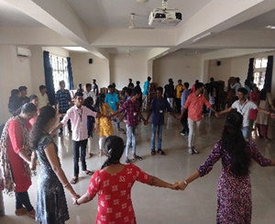
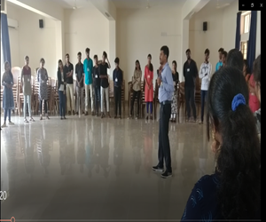
Activities conducted
1.Skill development to improve communication skills with healthy environment.
Date: 29-02-2020
Year: 2019-2020
Venue: SDM PG CENTER SEMINAR HALL
Resource Person:
Mr. Shankar
Assistant Professor
Dept of Commerce
Vani PU College Belthangady.

Slide 24
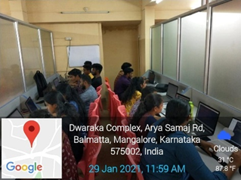
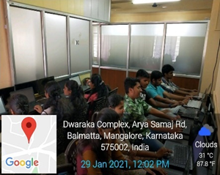
Activities conducted
Activities conducted
2. Employability development activity on Android Application Development Using Ionic Framework Conducted under “SOFTIONIK”
Date: 27-01-2021 TO 09-02-2021
Year: 2020-2021
Venue: Softionik Company,
#16-6-292/18, 2nd Floor, Dwaraka Complex,
Araya Samaja Road Balmatta Mangalore-565 003.
Resource Person:
Mr. Sunil
Software Developer
Softionik

Slide 25
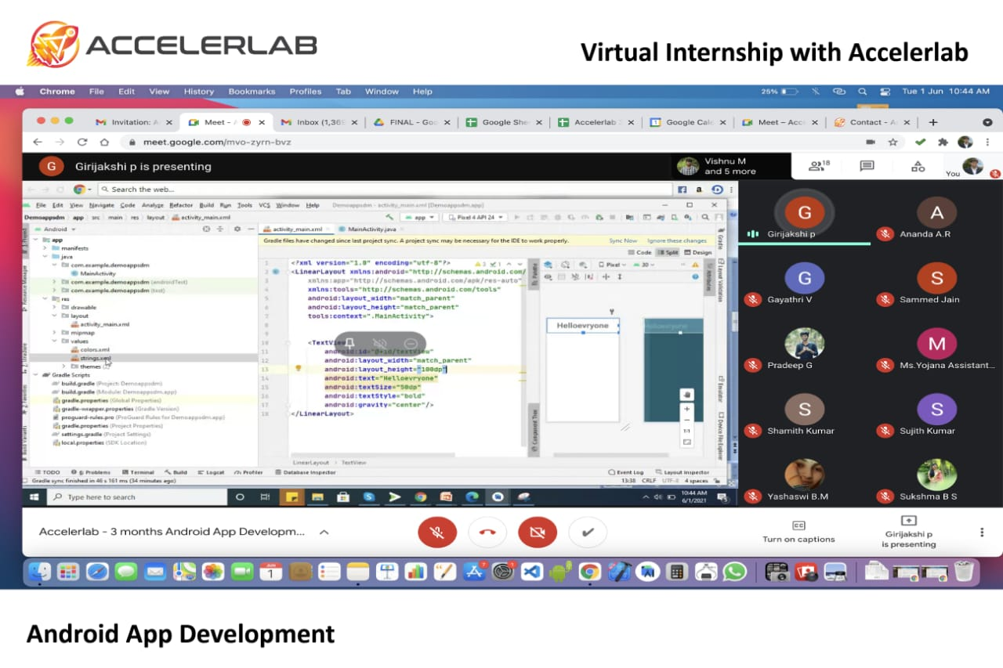
Activities conducted
Activities conducted
3. Employability development activity on Android Application Development Using Ionic Framework Conducted under “SOFTIONIK”
Date: 01-06-2021 TO 31-08-2021
Year: 2020-2021
Venue: Virtual Internship with Accelerab
Resource Person:
Mr. Vaishak Shetty
Software Developer
Accelerlab Technologies Pvt Ltd.

Slide 26
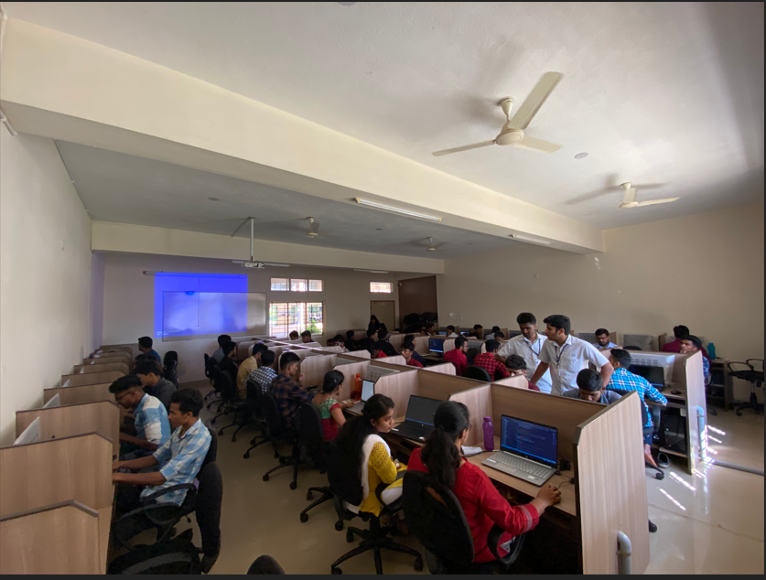
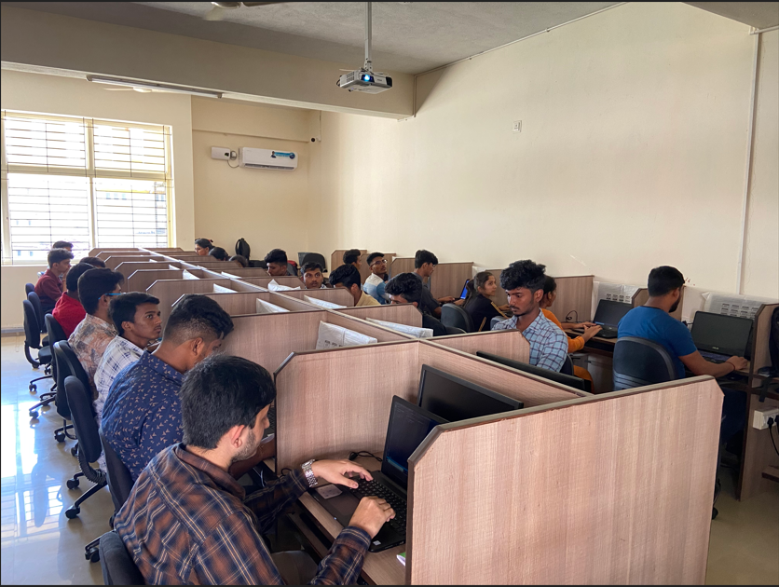
Activities conducted
Activities conducted
4. Employability development activity on Workshop on HTML, CSS, BOOTSTRAP & JAVA SCRIPT & GIT HUB Conducted under “ACCELERLAB”.
Date: 29-01-2021 TO 15-02-2021
Year: 2020-2021
Venue: SDM PG Center Computer Programming Lab
Resource Person:
Mr. Vaishak Shetty
Software Developer
Accelerlab Technologies Pvt Ltd.

Slide 27
Activities conducted
International webinar
International webinar on “Look beyond the Normal: Ace the technical beat” on 29th may 2021 on WebEx platform by MR SANDESH B SUVARNA.

Slide 28
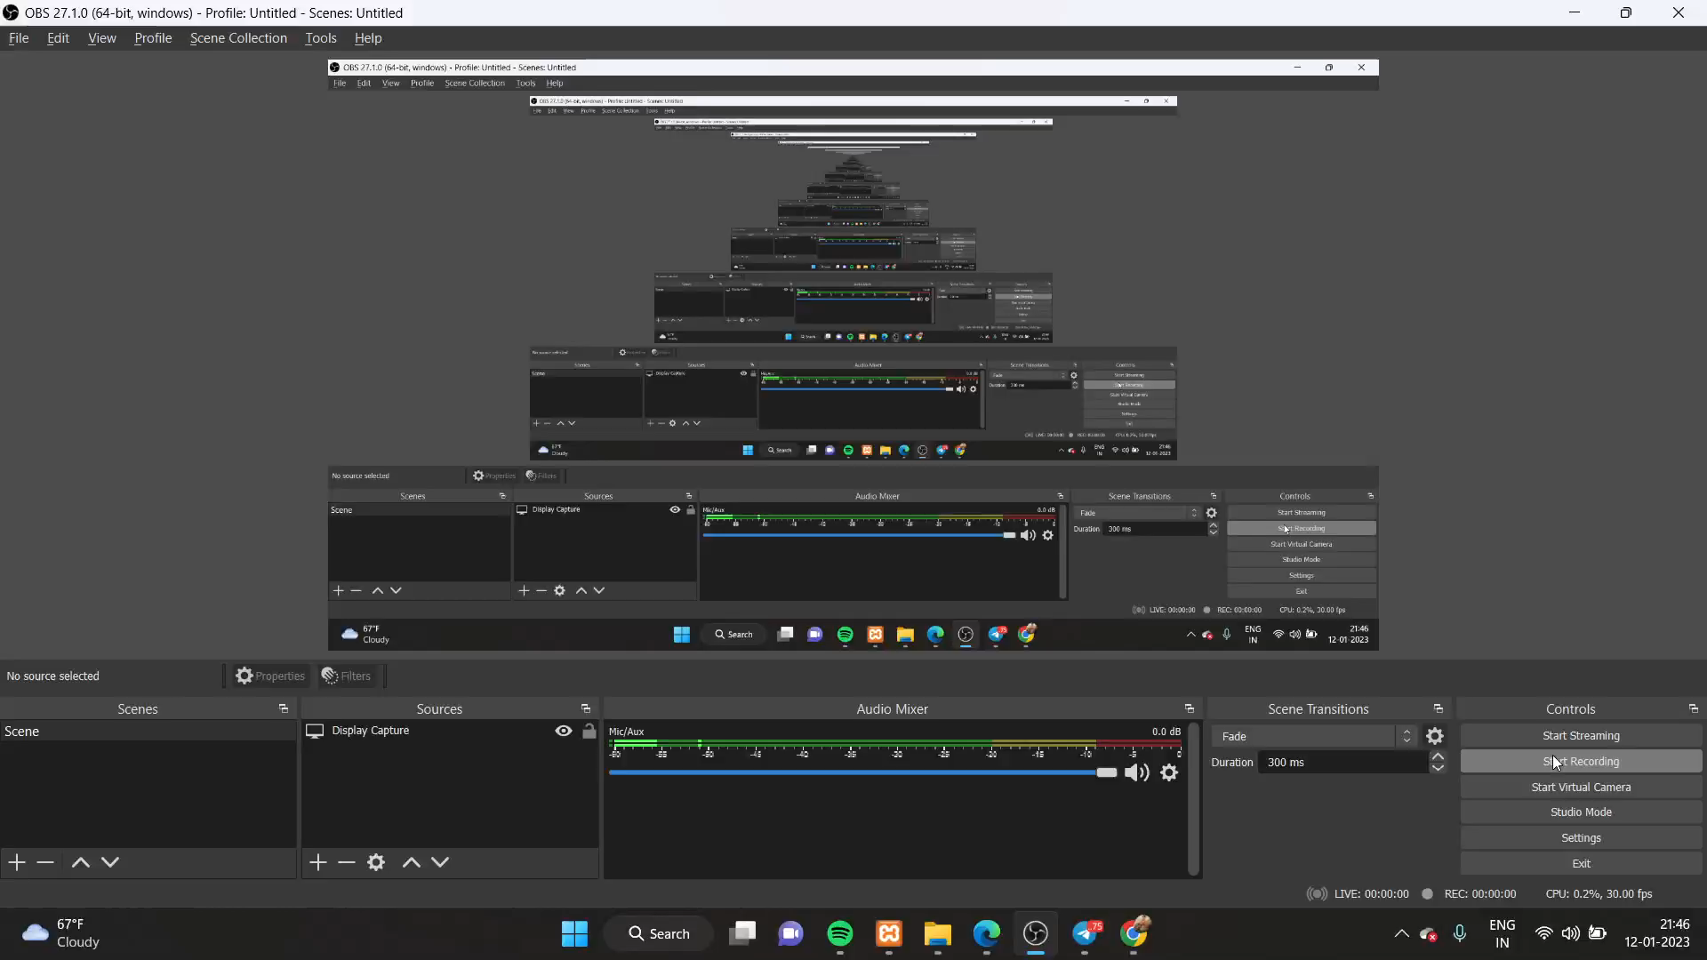
Major Projects S.D.M-Canteen Management System

Slide 29
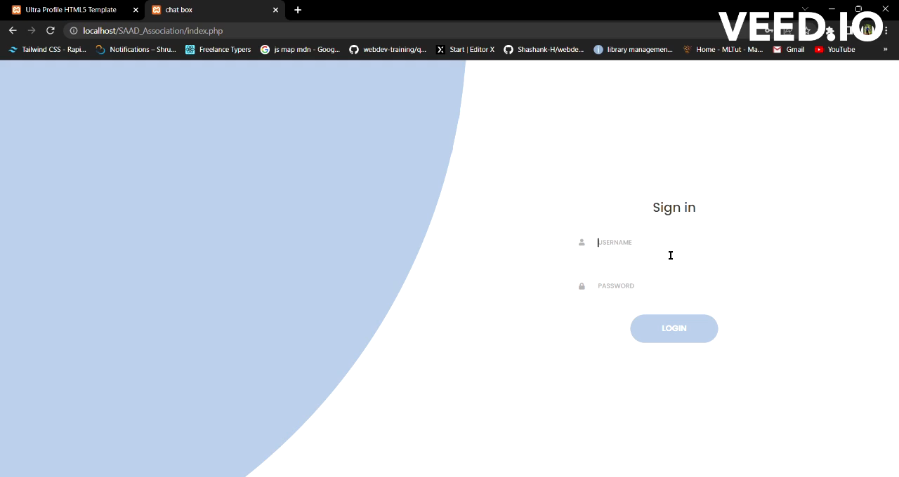
B.Voc in S&AD Student Association System

Slide 30
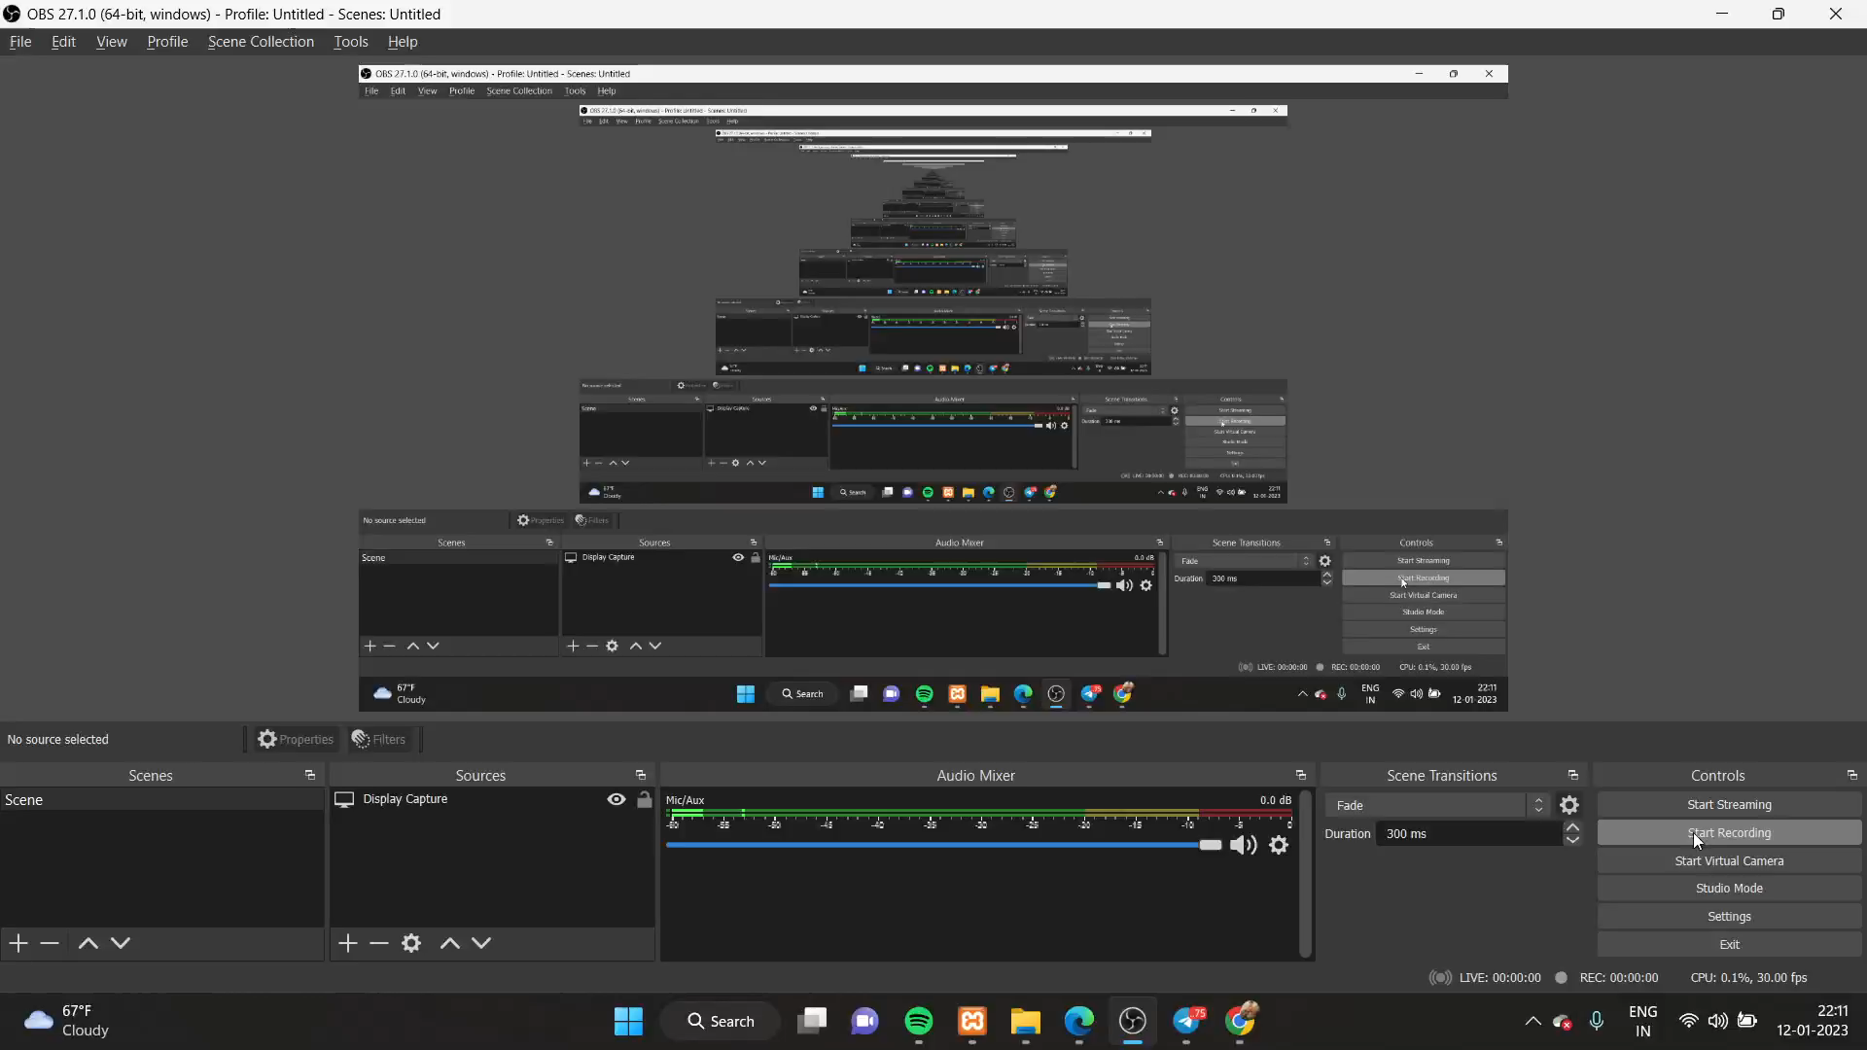
S.D.M Hostel Mess Food Rating Management System

Slide 31

S.D.M Arboretum mobile application

Slide 32
Future Enhancement
Increasing the number of industrial associations
Organising international conference on current technology
Encouragement for student start-up.
Department IT consultancy

Slide 33
THANK YOU

